Slide 1
Automatic Recording Again
Session 8a on Wed, 22 Nov 2023 and 8b on Sat 8b on Sat, 25 Nov 2023 are automatically recorded again (yes, confirmed)

Slide 2
IT5003
The last (8th) Week and the last Wed class
SSSP round 2 (weighted)
Course wrap up

Slide 3
Admin: Venue Confirmation
Fri, 24 Nov 2023, 2-4pm last recitation r8 at SR@LT19
COM1-2-SR1 is interestingly used for “final exam stuff”
I thought all final assessment venues are outside SoC venues for this sem due to construction noise
Let’s see campus map on where this SR@LT19 is (it is basically next to LT19)
https://map.nus.edu.sg/#page=map&long=103.7745824000000000&lat=1.2939822580000000
Sat, 25 Nov 2023, 10am-12nn lab venues should be available and unlocked
Unlike last Sat, 18 Nov for *some* groups…
Mon, 27 Nov 2023, 2-4pm and 4-6pm lab venues should be available too
Unlike last Mon, 20 Nov 2023, for 2-4pm groups…

Slide 4
Review of SSSP Problem
Some earlier slides + https://visualgo.net/en/sssp?slide=8 to 8-5
Q&A on SSSP part 3:
Review: BFS canNOT be used for weighted SSSP
Negative weight cycles cause ill-defined shortest paths case – side stepped in IT5003…
The modification of Dijkstra’s algorithm
Quick intuitive “proof” of Dijkstra’s correctness (FYI only),
The lazy update technique for “DecreaseKey” operation using a standard Min PQ,
The time complexity analysis of O((V+E) log V) for non-negative weighted graphs
SSSP on DAG (toposort helps)
Not discussed:
Exponential worst-case behavior of Modified Dijkstra’s on exponential number of (SSSP) spanning trees (only for negative weighted graphs)
The original Dijkstra’s algorithm, its balanced BST implementation (hard to do this in Python – sidestepped too), also O((V+E) log V)
Notes:
BFS are only correct to solve SSSP problem on unweighted (weights all 1) or constant-weighted (weights all c, c >= 1) graphs (c all 0 degenerates to connectivity test problem, negative c causes –ve cycle – undefined).
Negative weights (without cycles) is still OK (still problematic for the original version of Dijkstra’s), but negative weights cycles cause ill-defined shortest paths case, for IT5003, let’s sidestep anything negative weight…
Modified Dijkstra’s explanations
The illustration shown in that Quora answer is one of the best to explain how Dijkstra’s works (not really a formal proof but it is sufficient for this module), let’s use https://visualgo.net/en/sssp, Example Graphs, Weighted, Big (got one cycle, so it is not a DAG) and edge weight with sufficient variations, set s = 0
Explaining the lazy PQ update idea for the crucial DecreaseKey PQ operation of Dijkstra’s algorithm,
Show that the time complexity is O((V+E) log V) because each vertex and each edge is processed only once (we have used this analysis technique several times) and we use O(log E) priority queue that can be written as O(log V^2) = O(2 log V) = O(log V) per operation;
SSSP on DAG is not that hard, but only applicable for DAG, we can return back to O(V+E) time complexity if the weighted graph is a DAG (negative weight is not a problem :O, no cycle by definition), perhaps just use the same example graph used tonight (Weighted, Big), but delete edge 4->1, so the weighted graph becomes a DAG
Not discussed
On the Dijstra’s killer worst case input, the time complexity can be exponential…
We didn’t discuss balanced BST properly, so we don’t use this version in IT5003

Slide 5
Checkpoint
Check the centralised recording (yes, it is recording properly)
Take class we-fie for SSG funded students (for audit purposes)

Slide 6
Not-Live Demo (bored…)
https://nus.kattis.com/problems/shortestpath1
A preview of how easy it is to write a working Dijkstra’s implementation
Using the modification of Dijkstra’s algorithm
Using Python’s heapq as the underlying PQ plus using Lazy Update technique
https://github.com/stevenhalim/cpbook-code/blob/master/ch4/sssp/dijkstra.py
Solution:
Just see shortestpath1.py that has been coded before and the comments

Slide 7
Live Demo
https://nus.kattis.com/problems/crosscountry
One of the easiest (standard, non-negative) weighted SSSP problem at Kattis
Solution:
Try modifying shortestpath1.py to solve this problem instead
2D array/matrix D is an Adjacency Matrix, is it useful to convert this to AL?
What is the time complexity (if we use Modified Dijkstra’s algorithm)?
What happened if “d > dist[u]” check is not done?
Can we have a faster solution?
Yes, we can…
See crosscountry.py (with subtle bugs sprinkled)
Notes:
Modified Dijkstra’s time complexity of O((V+E) log V) becomes O(N^2 log N) as the input graph is a complete weighted graph (medium sized, 1000x1000).
There is an alternative version of Dijkstra’s on complete weighted graph that can run in faster O(N^2) time, not that hard to modify (avoid PQ, use O(n) loop to find next min), but a bit longer code than Modified Dijkstra’s…,

Slide 8
Summary of Our 7.5 Weeks (1)
W | Examinable Topics | Not Taught (or in Recitation)
1 | Python review (IT5001) and the usually short coding style Analysis of Algorithms: O(1), O(log n), O(n), O(n log n), O(n²), O(n³) | Other “illegal” coding techniques O(2^{n}), O(n!)-soon, other complexities
2 | Sorting, O(n²) algorithms: Bubble, Selection, Insertion; O(n log n) Merge Sort (a stable sort that is inside Python list.sort()); (Randomized) Quick Sort; Special O(n+k) Counting Sort | O(d*(n+k)) Radix Sort, Other sorting algorithms

Slide 9
Summary of Our 7.5 Weeks (2)
W | Examinable Topics | Not Taught (or in Recitation)
1 | Python review (IT5001) and the usually short coding style Analysis of Algorithms: O(1), O(log n), O(n), O(n log n), O(n2), O(n3) | Other “illegal” coding techniques O(2^{n}), O(n!)-soon, other complexities
2 | Sorting, O(n2) algorithms: Bubble, Selection, Insertion; O(n log n) Merge Sort (a stable sort that is inside Python list.sort()); (Randomized) Quick Sort; Special O(n+k) Counting Sort | O(d*(n+k)) Radix Sort, Other sorting algorithms
3 | List ADT, Python list, SLL, Stack ADT, Python list as stack, Queue ADT, Python list as queue is slow (alternative: circular queue; 2 stacks), Python deque (Doubly Linked List) | Details of Python deque (esp its O(1) []) Other LL problems/techniques
4 | Priority Queue ADT, Binary Heap DS, Python heapq Create Heap O(n log n) and O(n) version, O(n log n) Heap Sort (or partial sort) | Other Priority Queue operations + HT Other Binary Heap quirks
5 | Table ADT, DAT, basic hashing, Separate Chaining, Python set/dict/defaultdict/Counter Alt Table ADT, Binary Search Tree (not necessarily balanced), no library (random build) | Harder stuffs about Hash Table: QP, DH, etc Self-balancing BST (AVL)+harder operations

Slide 10
Summary of Our 7.5 Weeks (3)
W | Examinable Topics | Not Taught (or in Recitation)
1 | Python review (IT5001) and the usually short coding style Analysis of Algorithms: O(1), O(log n), O(n), O(n log n), O(n2), O(n3) | Other “illegal” coding techniques O(2n), O(n!)-soon, other complexities
2 | Sorting, O(n2) algorithms: Bubble, Selection, Insertion; O(n log n) Merge Sort (a stable sort that is inside Python list.sort()); (Randomized) Quick Sort; Special O(n+k) Counting Sort | O(d*(n+k)) Radix Sort, Other sorting algorithms
3 | List ADT, Python list, SLL, Stack ADT, Python list as stack, Queue ADT, Python list as queue is slow (alternative: circular queue; 2 stacks), Python deque (Doubly Linked List) | Details of Python deque (esp its O(1) []) Other LL problems/techniques
4 | Priority Queue ADT, Binary Heap DS, Python heapq Create Heap O(n log n) and O(n) version, O(n log n) Heap Sort (or partial sort) | Other Priority Queue operations + HT Other Binary Heap quirks
5 | Table ADT, DAT, basic hashing, Separate Chaining, Python set/dict/defaultdict/Counter Alt Table ADT, Binary Search Tree (not necessarily balanced), no library (random build) | Harder stuffs about Hash Table: QP, DH, etc Self-balancing BST (AVL)+harder operations
6 | Graph, basic graph theory, 3 graph DS: AM/AL/EL (or implicit), simple graph DS applications | Other rare special graph(s) (DSes)
7 | Graph Traversal: DFS, BFS, reachability test, printing path, finding CCs/flood fill (2d implicit graph), cycle check, topological sorting of a DAG, SSSP1: BFS, all custom algorithms | DFS/BFS have other (harder) apps: Bipartite-check, SCC, cut vertex/bridge, 2-SAT, etc
8 | SSSP2: BFS/Dijkstra’s for unweighted/weighted graph, respectively, on DAG (toposort/DP) | Other harder SSSP variants: -ve weight, etc

Slide 11
Summary of Our 7.5 Weeks (4)
W | Examinable Topics | Not Taught (or in Recitation)
1 | Python review (IT5001) and the usually short coding style Analysis of Algorithms: O(1), O(log n), O(n), O(n log n), O(n²), O(n³) | Other “illegal” coding techniques O(2^{n}), O(n!)-soon, other complexities
2 | Sorting, O(n²) algorithms: Bubble, Selection, Insertion; O(n log n) Merge Sort (a stable sort that is inside Python list.sort()); (Randomized) Quick Sort; Special O(n+k) Counting Sort | O(d*(n+k)) Radix Sort, Other sorting algorithms
3 | List ADT, Python list, SLL, Stack ADT, Python list as stack, Queue ADT, Python list as queue is slow (alternative: circular queue; 2 stacks), Python deque (Doubly Linked List) | Details of Python deque (esp its O(1) []) Other LL problems/techniques
4 | Priority Queue ADT, Binary Heap DS, Python heapq Create Heap O(n log n) and O(n) version, O(n log n) Heap Sort (or partial sort) | Other Priority Queue ADT operations + HT Other Binary Heap quirks
5 | Table ADT, DAT, basic hashing, Separate Chaining, Python set/dict/defaultdict/Counter Alt Table ADT, Binary Search Tree (not necessarily balanced), no library (random build) | Harder stuffs about Hash Table: QP, DH, etc Self-balancing BST (AVL)+harder operations
6 | Graph, basic graph theory, 3 graph DS: AM/AL/EL (or implicit), simple graph DS applications | Other rare special graph(s) (DSes)
7 | Graph Traversal: DFS, BFS, reachability test, printing path, finding CCs/flood fill (2d implicit graph), cycle check, topological sorting of a DAG, SSSP1: BFS, all custom algorithms | DFS/BFS have other (harder) apps: Bipartite-check, SCC, cut vertex/bridge, 2-SAT, etc
8 | SSSP2: BFS/Dijkstra’s for unweighted/weighted graph, respectively, on DAG (toposort/DP) | Other harder SSSP variants: -ve weight, etc

Slide 12
Summary of Our 7.5 Weeks (5)
W | Examinable Topics | Not Taught (or in Recitation)
1 | Python review (IT5001) and the usually short coding style Analysis of Algorithms: O(1), O(log n), O(n), O(n log n), O(n2), O(n3) | Other “illegal” coding techniques O(2^{n}), O(n!)-soon, other complexities
2 | Sorting, O(n2) algorithms: Bubble, Selection, Insertion; O(n log n) Merge Sort (a stable sort that is inside Python list.sort()); (Randomized) Quick Sort; Special O(n+k) Counting Sort | O(d*(n+k)) Radix Sort, Other sorting algorithms
3 | List ADT, Python list, SLL, Stack ADT, Python list as stack, Queue ADT, Python list as queue is slow (alternative: circular queue; 2 stacks), Python deque (Doubly Linked List) | Details of Python deque (esp its O(1) []) Other LL problems/techniques
4 | Priority Queue ADT, Binary Heap DS, Python heapq Create Heap O(n log n) and O(n) version, O(n log n) Heap Sort (or partial sort) | Other Priority Queue ADT operations + HT Other Binary Heap quirks
5 | Table ADT, DAT, basic hashing, Separate Chaining, Python set/dict/defaultdict/Counter Alt Table ADT, Binary Search Tree (not necessarily balanced), no library (random build) | Harder stuffs about Hash Table: QP, DH, etc Self-balancing BST (AVL)+harder operations
6 | Graph, basic graph theory, 3 graph DS: AM/AL/EL (or implicit), simple graph DS applications | Other rare special graph(s) (DSes)
7 | Graph Traversal: DFS, BFS, reachability test, printing path, finding CCs/flood fill (2d implicit graph), cycle check, topological sorting of a DAG, SSSP1: BFS, all custom algorithms | DFS/BFS have lots of other interesting potential (harder) applications
8 | SSSP2: BFS/Dijkstra’s for unweighted/weighted graph, respectively, on DAG (toposort/DP) | Other harder SSSP variants

Slide 13
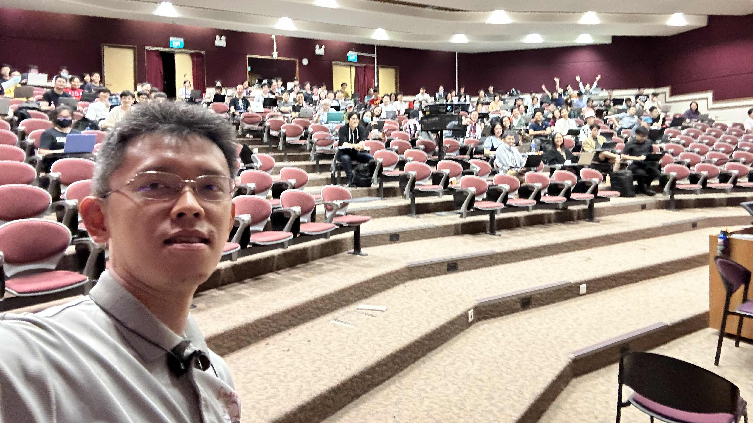
Class Picture Sem2 AY22/23, last semester (Apr 2023)

Slide 14
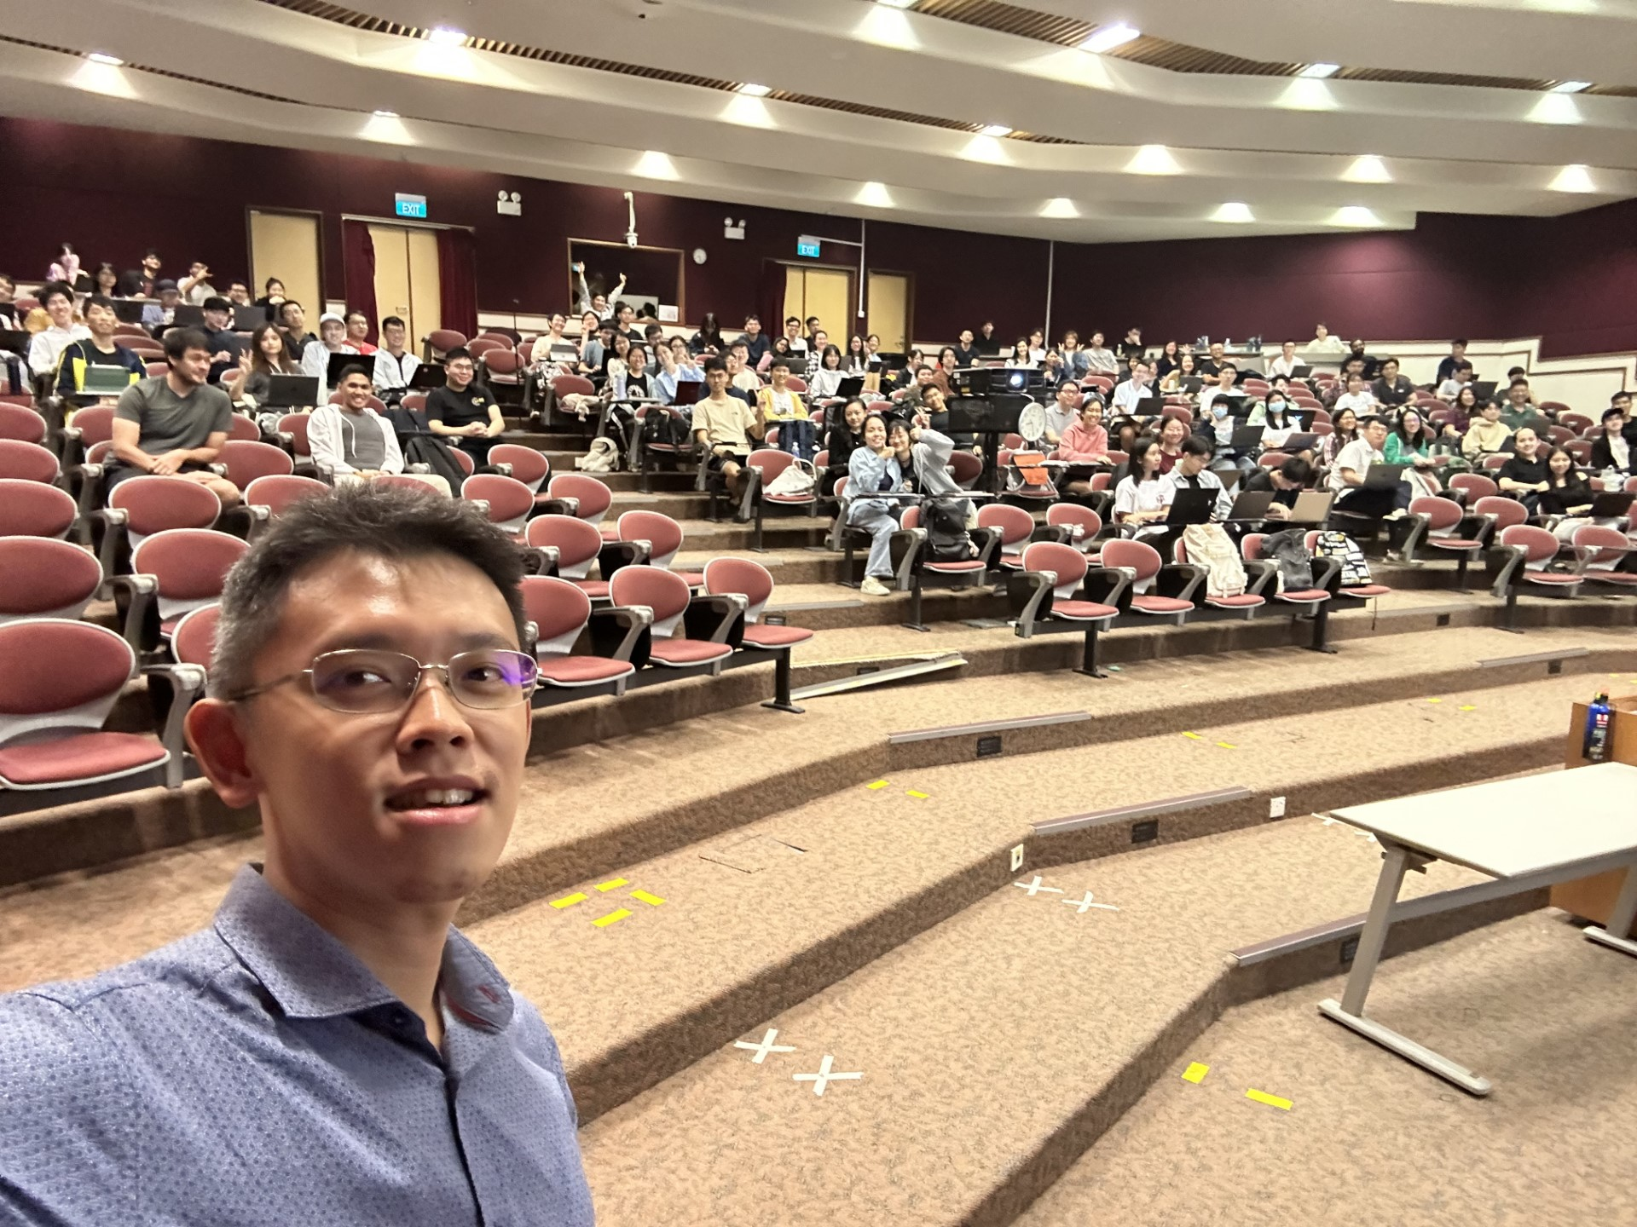
Class Picture Sem1 AY23/24, same angle, different people

Slide 15
Admin: Teaching feedback rate
As of Thu, 23 Nov 2023, 1pm, only 55/201 (27%) have done this
This thing closes on Friday night (this Friday night)
Need > 50% feedback rate for this to be meaningful

Slide 16

For last recitation r8
The plan is to discuss:
Some more of past paper discussion (you may want to review the recording)
Final assessment details :O (you may want to review the recording)

Slide 17
For last lecture L8a (first 25m only)
There is nothing to self-read for the (real) last class, we will discuss:
A preview of “The Limit of Computation”
The harder algorithmic stuff beyond this 8-weeks module
9.00-9.25am only
Note: The last PS8 also runs for one week, i.e., until Wed, 26 Nov 2023, 07.59am

Slide 18
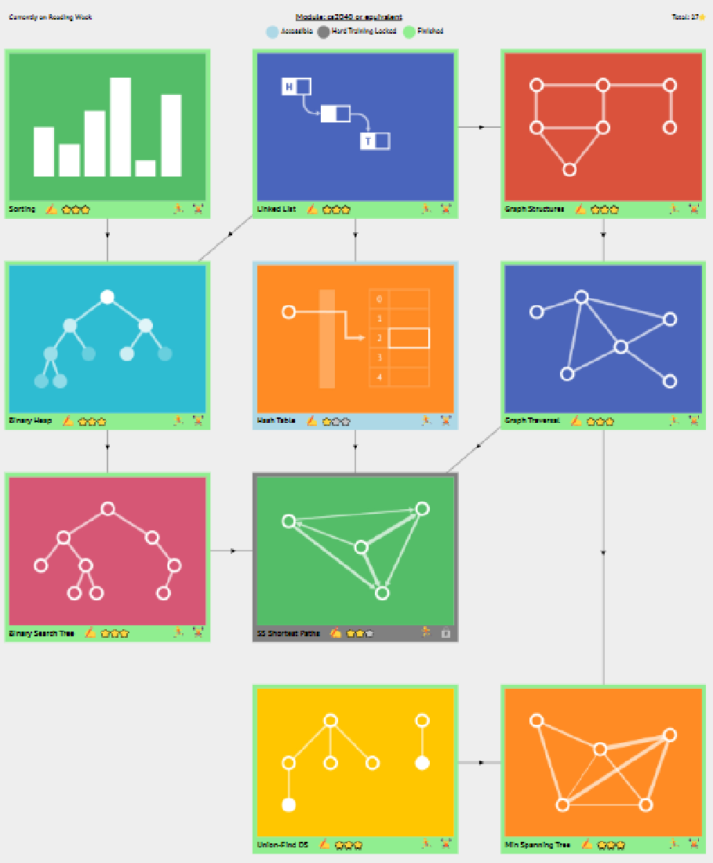
VisuAlgo Online Quiz 3 (9%)
Go to https://visualgo.net/tests
Topics tested:
/sorting, /list/, /heap, /hashtable (no QP/DH), /bst (no AVL)
1+1+1+1+1 = 5 hard questions (so you can’t “forget” the first 5 weeks…)
/graphds, /dfsbfs, /sssp (no Bellman-Ford; no -ve weighted edges)
3+3+2 = 8 hard questions
FAQ: Adjustment to VA system will be done by Fri, 24 Nov bef r8
15 random questions (different per student), 15 minutes
Plus 2 never-seen-before questions, not in training mode
Must be present at iCube-Auditorium this Sat, 25 Nov:
4 official absences so far (go to Thu, 7 Dec 23, 4.00-4.15pm makeup)
3 groups (67 pax each) to reduce peak server load:
9.30-9.45am, 9.31-9.45am, and 9.32-9.47am

